Slide 1
Unigram Language Model

Slide 2
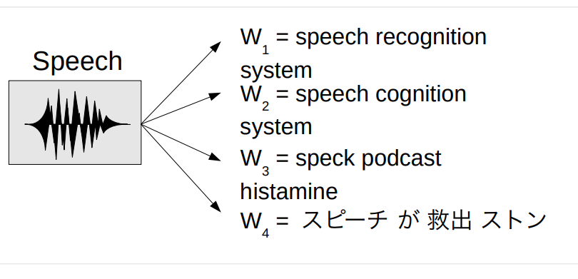
Why Language Models?
● We have an English speech recognition system, which
answer is better?

Slide 3
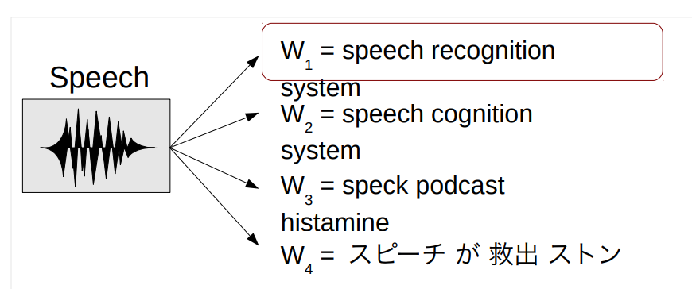
Why Language Models?
● We have an English speech recognition system, which
answer is better?
● Language models tell us the answer!

Slide 4
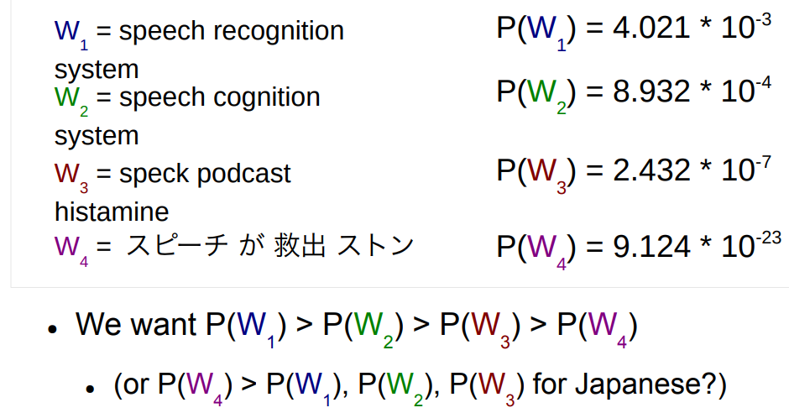
Probabilistic Language Models
● Language models assign a probability to each
sentence

Slide 5
Calculating Sentence Probabilities
● We want the probability of
W = speech recognition system
● Represent this mathematically as:
P(|W| = 3, w1=”speech”, w2=”recognition”, w3=”system”)

Slide 6
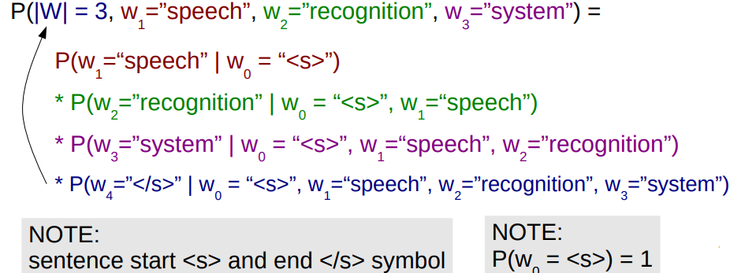
Calculating Sentence Probabilities
● We want the probability of
W = speech recognition system
● Represent this mathematically as (using chain rule):

Slide 7


Incremental Computation
● Previous equation can be written:
● How do we decide probability?

Slide 8
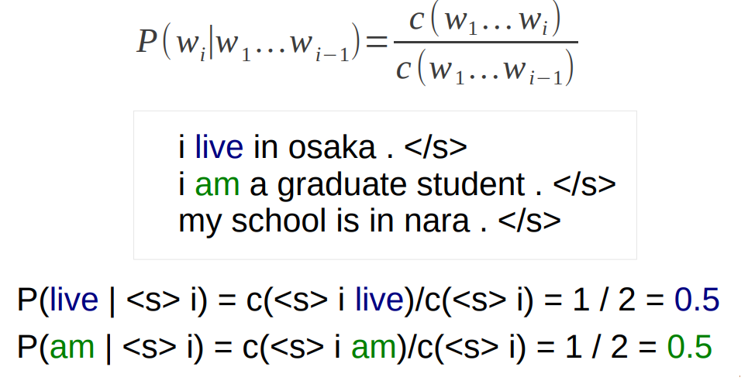
Maximum Likelihood Estimation
● Calculate word strings in corpus, take fraction

Slide 9
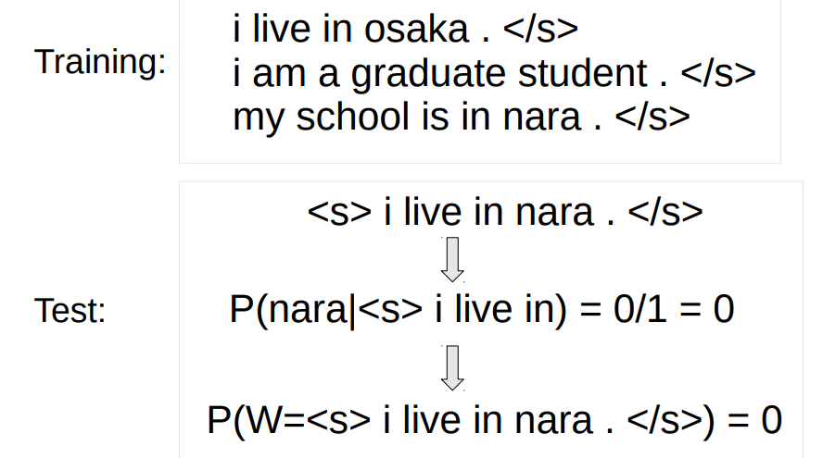
Problem With Full Estimation
● Weak when counts are low:

Slide 10
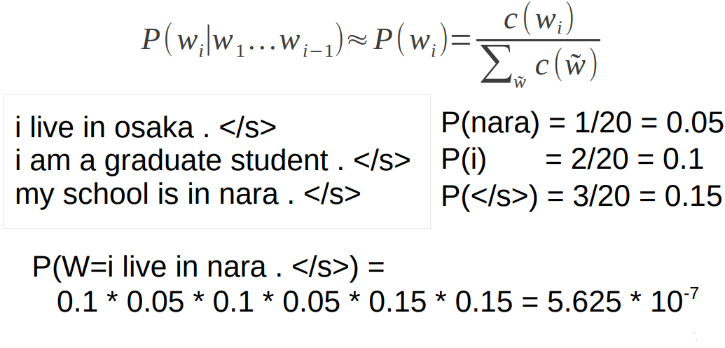
Unigram Model
● Do not use history:

Slide 11
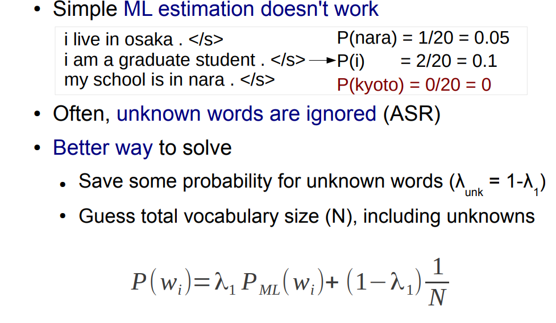
What about Unknown Words?!

Slide 12
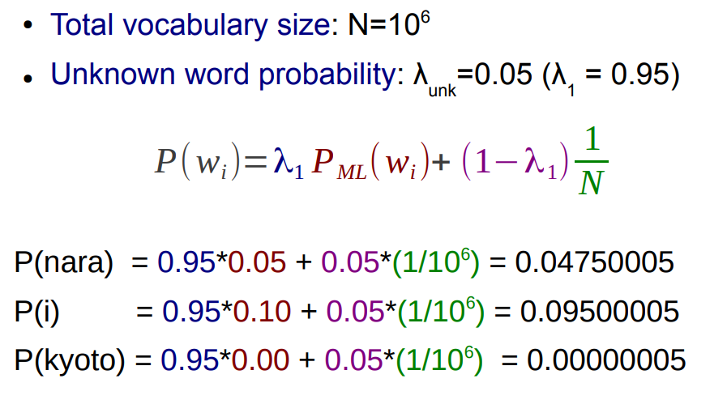
Unknown Word Example

Slide 13
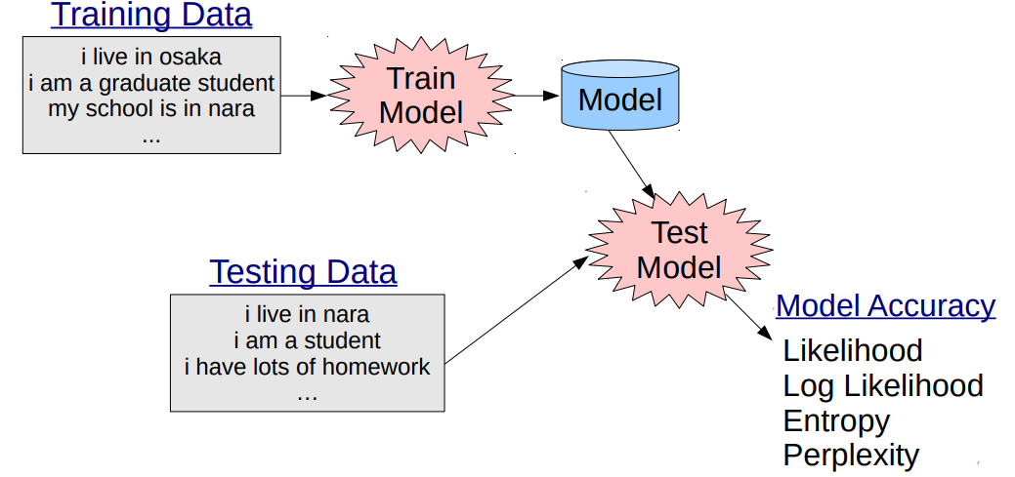
Experimental Setup
Use training and test sets

Slide 14
Evaluating Language Models

Slide 15
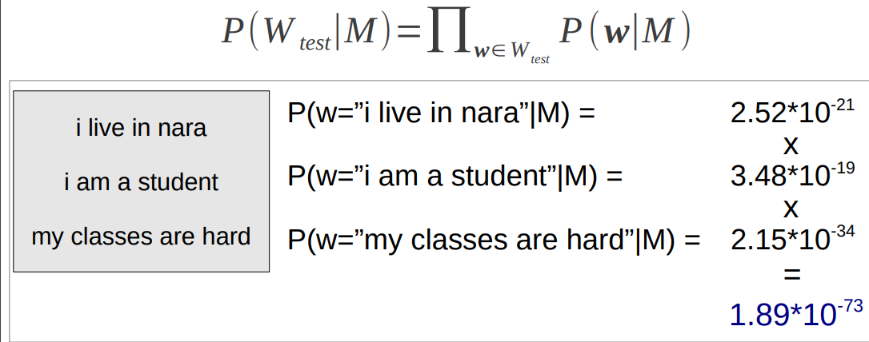
Likelihood
● Likelihood is the probability of some observed data (the test set Wtest ), given the model M

Slide 16
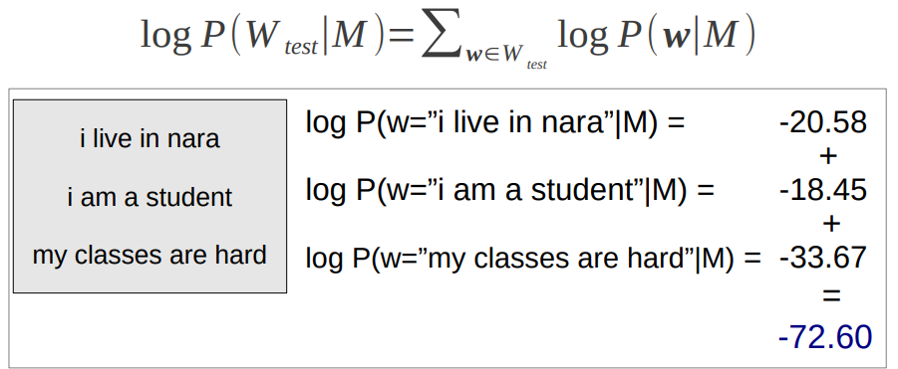
Log Likelihood
● Likelihood uses very small numbers=underflow
● Taking the log resolves this problem

Slide 17
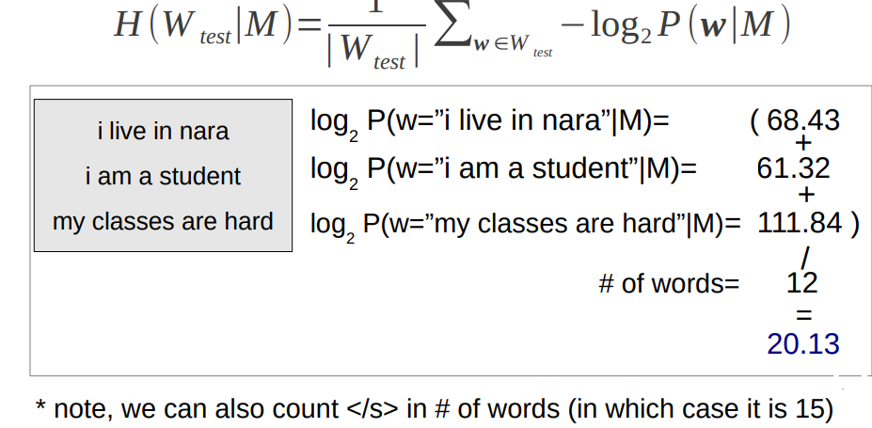
Entropy
● Entropy H is average negative log2 likelihood per word

Slide 18

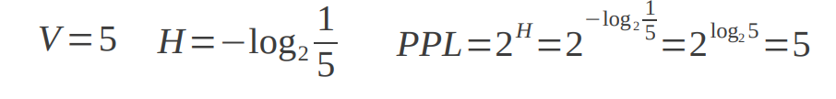
Perplexity
● Equal to two to the power of per-word entropy
● (Mainly because it makes more impressive numbers)
● For uniform distributions, equal to the size of
vocabulary

Slide 19
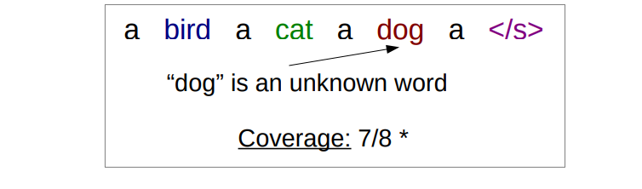
Coverage
● The percentage of known words in the corpus
* often omit the sentence-final symbol → 6/7

Slide 20
Exercise
● Write two programs
● train-unigram: Creates a unigram model
● test-unigram: Reads a unigram model and calculates
entropy and coverage for the test set
● Test them test/01-train-input.txt test/01-test-input.txt
● Train the model on data/wiki-en-train.word
● Calculate entropy and coverage on data/wiki-entest.word

Slide 21
train-unigram Pseudo-Code
create a map counts
create a variable total_count = 0
for each line in the training_file
split line into an array of words
append “</s>” to the end of words
for each word in words
add 1 to counts[word]
add 1 to total_count
open the model_file for writing
for each word, count in counts
probability = counts[word]/total_count
print word, probability to model_file

Slide 22
test-unigram Pseudo-Code

Slide 23
Load Model
create a map probabilities
for each line in model_file
split line into w and P
set probabilities[w] = P

Slide 24
Test and Print
for each line in test_file
split line into an array of words
append “</s>” to the end of words
for each w in words
add 1 to W
set Punk = λ / V
if probabilities[w] exists
set P += λ1* probabilities[w]
else
add 1 to unk
add -log2
P to H
print “entropy = ”+H/W
print “coverage = ” + (W-unk)/W

